Slide 1
SI 501 F21: Week 3
Agenda
Initial client meetings
Background research report
Networking for jobs / internships
Team time

Slide 2
Initial Client Meeting – Questions?
Initial meeting scheduled?
Any unresponsive clients?
Did any teams already have their meetings? How did it go?
Any questions about how you should you present yourself? (Attire, etc.)
Questions about meeting content?
Any other questions?

Slide 3
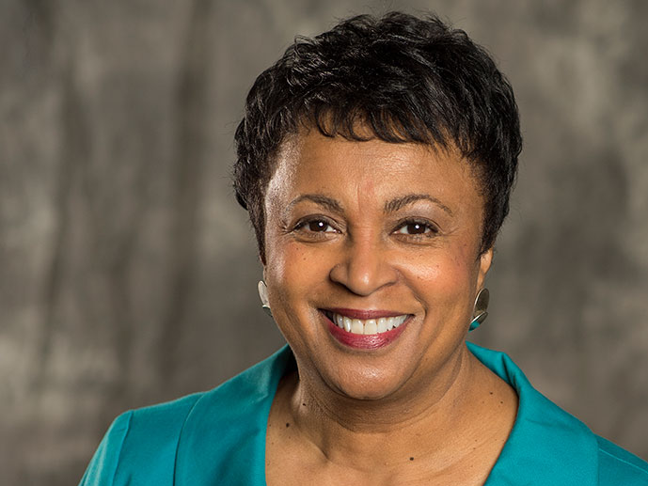

Sundar Pichai
CEO of Google
Carla Hayden
Librarian of Congress

Slide 4

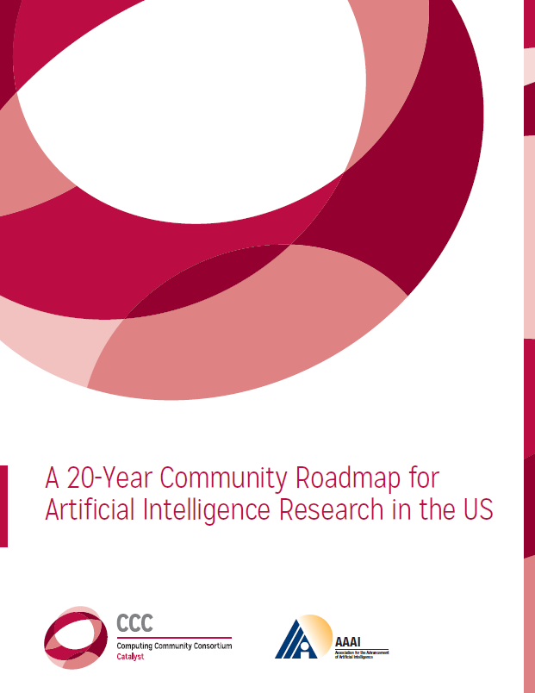

Slide 5
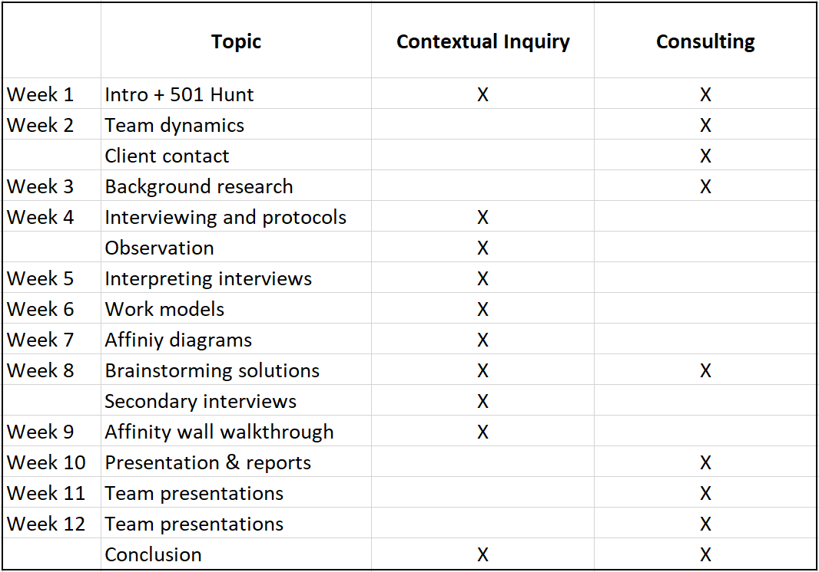
Course Overview

Slide 6
Background Research Reports
2000-word report that provides some insight about your client, client project, potential solutions, or anything related to them, based on background research.
High-quality sources
Well-synthesized information
Writing quality
Correct use of citations
Formatting

Slide 7
Background Research Reports
2000-word report that provides some insight about your client, client project, potential solutions, or anything related to them, based on background research.
High-quality sources
Well-synthesized information
Writing quality
Correct use of citations
Formatting High-quality sources

Slide 8
With respect to sources,
“high-quality” = credible
Generally Credible
Not as Credible
Articles in respected newspapers
Books published by established publishers
Scholarly journal articles
“Grey literature” by respected institutions
Official government reports/data
Organization’s own website, brochures, etc.
Webpages with unreliable sources or editing processes
Blog posts
Social media posts / tweets
Articles, books, reports, whitepapers published by less established organizations
It’s OK to use some less credible sources, but wherever possible, use credible ones.

Slide 9
If you have difficulty finding relevant sources for your Background Research Report, contact your GSI and/or…
Rebecca Welzenbach
Information Science Librarian rwelzenb@umich.edu
If you do, be sure to explain what kind of information you’re looking for, as well as what types of searches you’ve already tried.

Slide 10
Background Research Reports
2000-word report that provides some insight about your client, client project, or anything related to them, based on background research.
High-quality sources
Well-synthesized information
Writing quality
Correct use of citations
Formatting High-quality sources

Slide 11
Discussion of Readings
Who is the primary audience that Webster & Watson (2002) had in mind?
Webster & Watson (2002) write that a literature review should be “______-centric.” What does this mean?
How might the specific advice in Webster & Watson (2002) be different for your background research report?
Who is the primary audience that Dowell & Carter (n.d.) had in mind?
Why do you think I keep asking that question?
How might the specific advice in Dowell & Carter (n.d.) be different for your background research report?
What are the common recommendations that occurred in all three readings for this week?

Slide 12
Background Research Reports
2000-word report that provides some insight about your client, client project, or anything related to them, based on background research.
High-quality sources
Well-synthesized information
Writing quality ← As appropriate for your English ability.
Correct use of citations ← Beware of “unintentional” PLAGIARISM!
Formatting ← Make it look professional.

Slide 13
In SI 501, between 2015-2018, what were the reasons given by students for instances of plagiarism?
A. “I didn’t know that was plagiarism.”
54
E. “I cut-and-pasted from my notes, and forgot...”
3
B. “I don’t usually make that mistake.”
10
F. “I was going to cite properly on resubmission.”
2
C. “My writing is poor, so copying others is better.”
7
G. “My plagiarism checker didn’t catch it.”
1
D. “I didn’t have time to check everything.”
6
H. “That wasn’t the version I meant to submit.”
1

Slide 14
About 90 cases of plagiarism over 3 years.
A. “I didn’t know that was plagiarism.”
54
E. “I cut-and-pasted from my notes, and forgot...”
3
B. “I don’t usually make that mistake.”
10
F. “I was going to cite properly on resubmission.”
2
C. “My writing is poor, so copying others is better.”
7
G. “My plagiarism checker didn’t catch it.”
1
D. “I didn’t have time to check everything.”
6
H. “That wasn’t the version I meant to submit.”
1

Slide 15
Read the following passage, and answer the question below. (This text is excerpted from Gary M. Olson and Judith S. Olson. (2000). Distance matters. Human-Computing Interaction, 15(2):139-178.)
  Could the technology ever get good enough to fully mimic the ease of interaction we see in face-to-face settings? Yes and no. We believe there is room for improvement over today’s technologies. However, even with the best design of high bandwidth, display of appropriate proxemics, access to shared objects, and so on, there will always be things about the remote situation that make it qualitatively different than collocation, including aspects of common ground and context, the effects of differing time zones, cultural differences, and various interactions among these and technology.
Which of the following are acceptable ways of using the content that avoid plagiarism? (Circle all that apply.)
There are many reasons why technology will never fully close the distance gap in communication. Even with the best design of high bandwidth, display of appropriate proxemics, or access to shared objects, there will always be things about the remote situation that are different from being in the same place (Olson & Olson, 2000).
There are a range of problems that collaboration technologies can never solve: “aspects of common ground and context, the effects of different times zones, cultural differences.” These problems will be present even with the best-designed technology.
Though better design could improve remote interaction, there are some things such as differences in time zones or culture that are unlikely ever to be bridged by technology.
Today’s technologies could be improved. But as noted by Olson & Olson (2000), even with good design – involving high bandwidth, distance cues, and shared displays – some things about remote communication make it different from collocation because of common understanding and context, time zones, differences in culture, and so on.
Online version: http://j.mp/si501plag

Slide 16
Online version: http://j.mp/si501plagsol
Read the following passage, and answer the question below. (This text is excerpted from Gary M. Olson and Judith S. Olson. (2000). Distance matters. Human-Computing Interaction, 15(2):139-178.)
  Could the technology ever get good enough to fully mimic the ease of interaction we see in face-to-face settings? Yes and no. We believe there is room for improvement over today’s technologies. However, even with the best design of high bandwidth, display of appropriate proxemics, access to shared objects, and so on, there will always be things about the remote situation that make it qualitatively different than collocation, including aspects of common ground and context, the effects of differing time zones, cultural differences, and various interactions among these and technology.
Which of the following are acceptable ways of using the content that avoid plagiarism? (Circle all that apply.)
There are many reasons why technology will never fully close the distance gap in communication. Even with the best design of high bandwidth, display of appropriate proxemics, or access to shared objects, there will always be things about the remote situation that are different from being in the same place (Olson & Olson, 2000).
There are a range of problems that collaboration technologies can never solve: “aspects of common ground and context, the effects of different times zones, cultural differences.” These problems will be present even with the best-designed technology.
Though better design could improve remote interaction, there are some things such as differences in time zones or culture that are unlikely ever to be bridged by technology.
Today’s technologies could be improved. But as noted by Olson & Olson (2000), even with good design – involving high bandwidth, distance cues, and shared displays – some things about remote communication make it different from collocation because of common understanding and context, time zones, differences in culture, and so on.
Exact same text. There is an in-text citation (good), but no quotation marks (bad!).

Slide 17
Online version: http://j.mp/si501plagsol
Read the following passage, and answer the question below. (This text is excerpted from Gary M. Olson and Judith S. Olson. (2000). Distance matters. Human-Computing Interaction, 15(2):139-178.)
  Could the technology ever get good enough to fully mimic the ease of interaction we see in face-to-face settings? Yes and no. We believe there is room for improvement over today’s technologies. However, even with the best design of high bandwidth, display of appropriate proxemics, access to shared objects, and so on, there will always be things about the remote situation that make it qualitatively different than collocation, including aspects of common ground and context, the effects of differing time zones, cultural differences, and various interactions among these and technology.
Which of the following are acceptable ways of using the content that avoid plagiarism? (Circle all that apply.)
There are many reasons why technology will never fully close the distance gap in communication. Even with the best design of high bandwidth, display of appropriate proxemics, or access to shared objects, there will always be things about the remote situation that are different from being in the same place (Olson & Olson, 2000).
There are a range of problems that collaboration technologies can never solve: “aspects of common ground and context, the effects of different times zones, cultural differences.” These problems will be present even with the best-designed technology.
Though better design could improve remote interaction, there are some things such as differences in time zones or culture that are unlikely ever to be bridged by technology.
Today’s technologies could be improved. But as noted by Olson & Olson (2000), even with good design – involving high bandwidth, distance cues, and shared displays – some things about remote communication make it different from collocation because of common understanding and context, time zones, differences in culture, and so on.
Exact same text. There are quotations marks (good), but no in-text citation or footnote (bad!).

Slide 18
Online version: http://j.mp/si501plagsol
Read the following passage, and answer the question below. (This text is excerpted from Gary M. Olson and Judith S. Olson. (2000). Distance matters. Human-Computing Interaction, 15(2):139-178.)
  Could the technology ever get good enough to fully mimic the ease of interaction we see in face-to-face settings? Yes and no. We believe there is room for improvement over today’s technologies. However, even with the best design of high bandwidth, display of appropriate proxemics, access to shared objects, and so on, there will always be things about the remote situation that make it qualitatively different than collocation, including aspects of common ground and context, the effects of differing time zones, cultural differences, and various interactions among these and technology.
Which of the following are acceptable ways of using the content that avoid plagiarism? (Circle all that apply.)
There are many reasons why technology will never fully close the distance gap in communication. Even with the best design of high bandwidth, display of appropriate proxemics, or access to shared objects, there will always be things about the remote situation that are different from being in the same place (Olson & Olson, 2000).
There are a range of problems that collaboration technologies can never solve: “aspects of common ground and context, the effects of different times zones, cultural differences.” These problems will be present even with the best-designed technology.
Though better design could improve remote interaction, there are some things such as differences in time zones or culture that are unlikely ever to be bridged by technology.
Today’s technologies could be improved. But as noted by Olson & Olson (2000), even with good design – involving high bandwidth, distance cues, and shared displays – some things about remote communication make it different from collocation because of common understanding and context, time zones, differences in culture, and so on.
Well-paraphrased text. No quotations marks needed,
but no in-text citation or footnote (bad!).

Slide 19
Online version: http://j.mp/si501plagsol
Read the following passage, and answer the question below. (This text is excerpted from Gary M. Olson and Judith S. Olson. (2000). Distance matters. Human-Computing Interaction, 15(2):139-178.)
  Could the technology ever get good enough to fully mimic the ease of interaction we see in face-to-face settings? Yes and no. We believe there is room for improvement over today’s technologies. However, even with the best design of high bandwidth, display of appropriate proxemics, access to shared objects, and so on, there will always be things about the remote situation that make it qualitatively different than collocation, including aspects of common ground and context, the effects of differing time zones, cultural differences, and various interactions among these and technology.
Which of the following are acceptable ways of using the content that avoid plagiarism? (Circle all that apply.)
There are many reasons why technology will never fully close the distance gap in communication. Even with the best design of high bandwidth, display of appropriate proxemics, or access to shared objects, there will always be things about the remote situation that are different from being in the same place (Olson & Olson, 2000).
There are a range of problems that collaboration technologies can never solve: “aspects of common ground and context, the effects of different times zones, cultural differences.” These problems will be present even with the best-designed technology.
Though better design could improve remote interaction, there are some things such as differences in time zones or culture that are unlikely ever to be bridged by technology.
Today’s technologies could be improved. But as noted by Olson & Olson (2000), even with good design – involving high bandwidth, distance cues, and shared displays – some things about remote communication make it different from collocation because of common understanding and context, time zones, differences in culture, and so on.
Patch-written text (bad!) is not paraphrasing!
Even with an in-text citation (good), this is not OK.

Slide 20
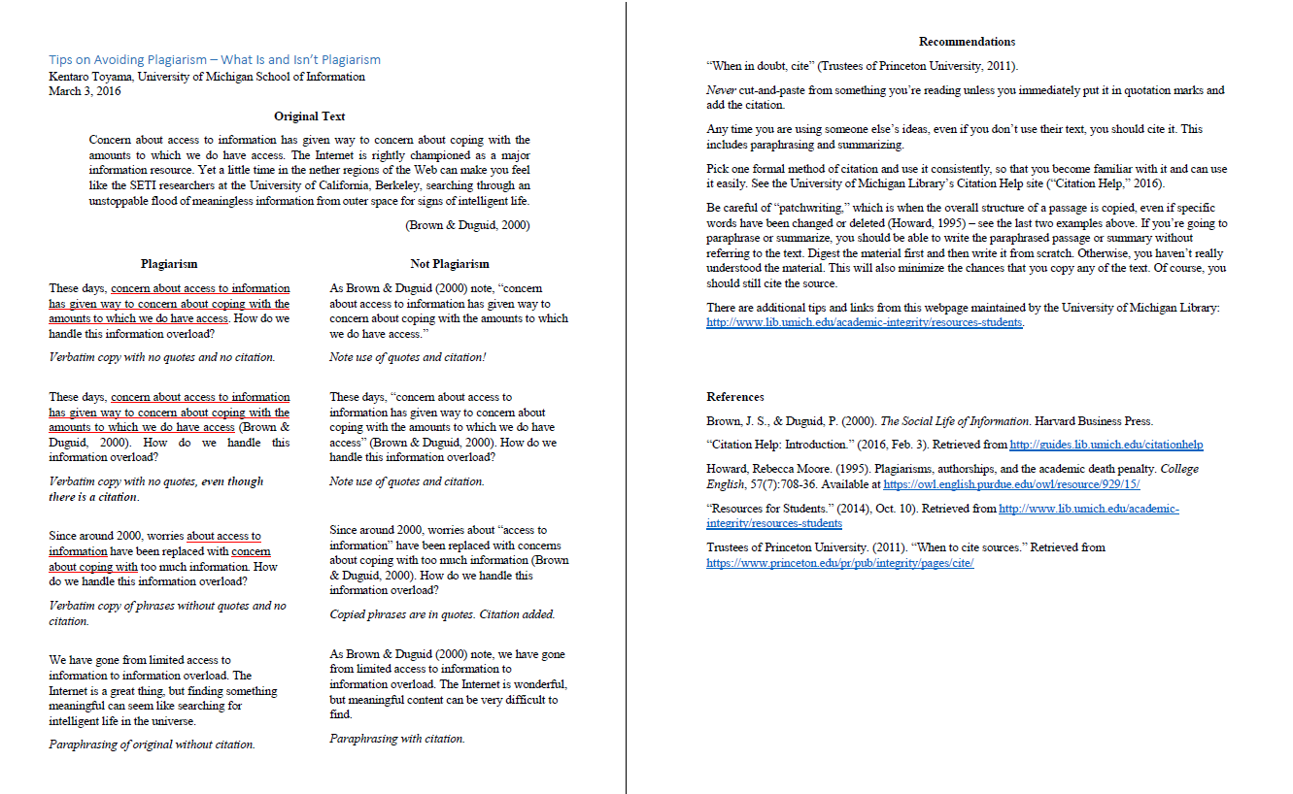
Canvas / Files / 00 Tips on Avoiding Plagiarism.pdf

Slide 21
Background Research Report Topics
Work with your team to figure out individual topics. The ideal situation is one where…
  Each team member has a different topic relevant to the client project.
  The topic anticipates what would be useful in the final report to the client.
It’s OK if…
  There is some topical overlap between team members.
  Two team members write about different aspects of the same topic.
Potential topics…
  General background about the client problem
  General background about the client organization
  Sector research about the larger community/market/industry the client organization is a part of
  Competitor analysis of the client organization’s main rivals
  Scholarly literature review about the general class of the client’s problem
  Review of potential solutions to the client’s problem
  Etc.

Slide 22
Background Research Report Tips
Individual assignment, but discuss with team to decide topics.
Start early! Most of you should not leave this assignment for the week before it’s due.
Read the guidelines in the assignment carefully.
Find something interesting to say. Digest and think hard about what your source materials contain as a whole. If possible, formulate clear arguments that support one or two key points.
Review sample papers in Canvas / Files / Sample Background Research Reports.
If you are not used to writing in English, schedule an appointment with Sweetland Writing Center in advance to review an outline the week of Sept. 27 or a report draft the week of Oct. 4. https://lsa.umich.edu/sweetland/graduates/writing-workshop.html

Slide 23
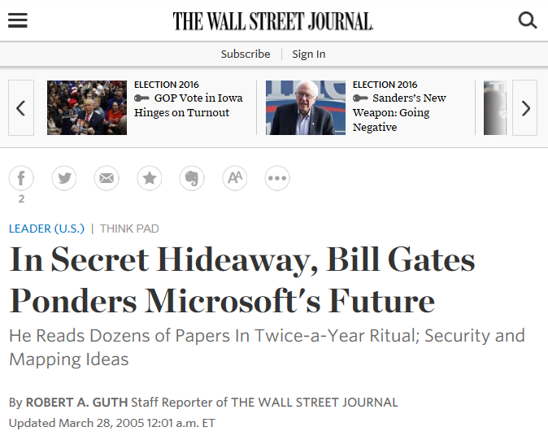

Slide 24
Background Research Report
[Individual Assignment]
2000-word report due Oct. 11, before Lecture.
Submit whatever you have before each Lecture until then:
  Sept. 27:
    Required: Cover page, initial bibliography
    Recommended: Outline
  Oct. 4:
    Required: Whatever you have in addition to above.
    Recommended: Draft of at least a few hundred words.
  Oct. 11:
    Final Background Research Report due

Slide 25
How to Network for Internships / Jobs in the United States
You are dramatically more likely to get a particular job if someone – anyone – puts you in touch with the hiring manager. That person can be anyone the hiring manager already knows or trusts.
Identify people who might know relevant hiring managers – employees, friends/family, people at relevant events.
Prepare an approach.
Contact them, get their contact information (if you don’t already have it), and follow up after the interaction with an email if at all possible.
When the time comes to “activate” your network, reply to the email thread you’ve established with them.
More detailed information at http://bit.ly/MSI-networking

Slide 26
Coming up…
Take the Quiz 3 on Canvas before Lecture on Sept. 27!
Submit cover letter and initial bibliography for your background research report before Lecture on Feb. 15.
Read Holtzblatt et al. (2005), Chap. 4 (pp. 79-100) and Weiss (1995). There will be a quiz next week.
Carry on with initial client meetings. Try to meet as early as possible, and definitely by Feb. 19. If you have problems scheduling this, or if you have an unresponsive client, don’t hesitate to let us know!
After you meet with your client, you can begin setting up interviews and observations for Feb. 22-Mar. 25. Don’t schedule any interviews before Feb. 22. Best time is Mar. 1 through Mar. 19.

Slide 27
Rest of Lecture and Discussion Section
Discuss Background Research Report topics with your team; decide who will write about what.
Consult with instructor / GSIs about any issues. E.g., difficulty identifying challenges Background Research Report topic, trouble with initial client meeting.
Go to your Discussion section, and start working on the Background Research Report. Team members can help each other with research report sources and ideas, though the writing should be done individually.
Your participation in Discussion counts toward your participation score.

